Slide 1

Earth System Model Evaluation Tool (ESMValTool):
Analyzing CMIP-style data made easy
B. Hassler and the ESMValTool development team
birgit.hassler@dlr.de

Slide 2
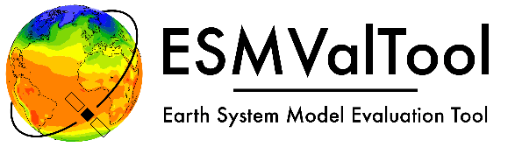
CMIP background
Birgit Hassler, SPARC Training School, Kigali/Rwanda, 2023-10-29

Slide 3
Coupled Model Intercomparison Project (CMIP)
CMIP began in 1995 under the auspices of the Working Group on Coupled Modelling (WGCM) which is part of the World Climate Research Program (WCRP)
Objective of CMIP is to better understand past, present and future climate changes arising from natural, unforced variability or in response to changes in radiative forcing
Analyses are based on a multi-model context
First set of common experiments involved comparing the model response to an idealized forcing (CO2 increase of 1% per year)
Important goal of CMIP is to make the multi-model output publicly available in a standardized format
Main focus on climate indicators like 2m temperature, precipitation, sea surface temperature…
CMIP
Birgit Hassler, SPARC Training School, Kigali/Rwanda, 2023-10-29

Slide 4

Coupled Model Intercomparison Project (CMIP)
Evolution from CMIP to CMIP6 with more and more modeling groups participating, more specifically defined experiments (some of them taylored towards capability to help answering specific science questions)
Continuously refined rules on which experiments/simulations need to be submitted for a modeling group to participate in the intercomparison
Definition of rules on how simulations are supposed to be submitted to the publicly available archives (specific formats, meta data, etc.)
Updated standards for the data (e.g. units, time variable, …)
Analyses based on climate models which became more and more complex over time (Earth system models)
CMIP
CMIP3
CMIP5
CMIP6
Birgit Hassler, SPARC Training School, Kigali/Rwanda, 2023-10-29

Slide 5
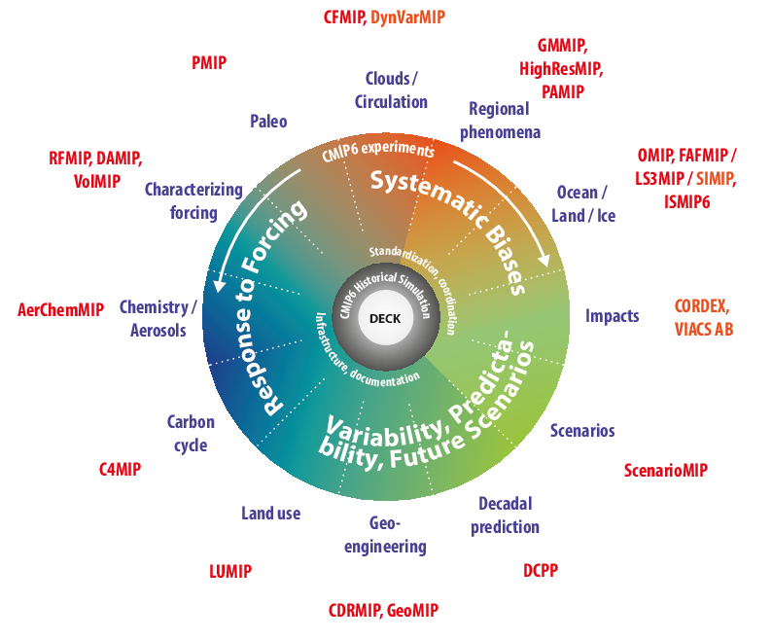

Coupled Model Intercomparison Project Phase 6 (CMIP6)
48 institutions/consortia have registered (CMIP5: 31)
126 models are registered (CMIP5: 59)
299 experiments defined (CMIP5: 33)
10 – 50 PB of model output expected (CMIP5: ~2 PB)
Higher complexity and resolution compared to CMIP5
→ Challenges for the entire community
Eyring et al., 2016
Birgit Hassler, SPARC Training School, Kigali/Rwanda, 2023-10-29

Slide 6
Model evaluation and benchmarking tools
Birgit Hassler, SPARC Training School, Kigali/Rwanda, 2023-10-29

Slide 7

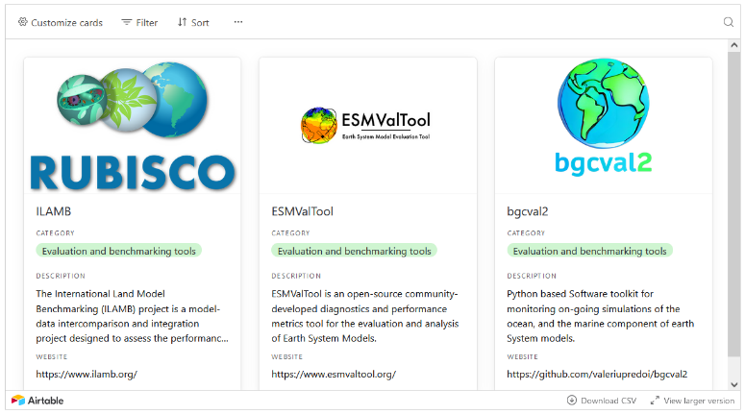


CMIP and the Model Benchmarking Task Team
In 2022 CMIP created seven Task Teams to support the design, scope, and definition of the next phase of CMIP and evolution of CMIP infrastructure and future operationalization
One of these task teams is focused on Model Benchmarking with two Co-Leads (Birgit Hassler and Forrest Hoffman) and 12 members
One of the things the TT has been working on is a collection of open-source model evaluation and benchmarking tools, centrally hosted in one place – since this Monday this collection in online available, and is continuously growing!
https://wcrp-cmip.org/tools/model-benchmarking-and-evaluation-tools/
Birgit Hassler, SPARC Training School, Kigali/Rwanda, 2023-10-29

Slide 8
ESMValTool
Birgit Hassler, SPARC Training School, Kigali/Rwanda, 2023-10-29

Slide 9
What is ESMValTool?
The Earth System Model Evaluation Tool (ESMValTool) is a community diagnostics and performance metrics tool for the evaluation and analysis of Earth System Models (ESMs; CMIP and CORDEX).
Community effort open to both users and developers
Wide scope: includes many diagnostics and performance metrics covering different aspects of the Earth system
High flexibility: new diagnostics and more observational data can be easily added
Multi-language support: Python, NCL, R, Julia... other open-source languages are possible
Reproducibility of the results (provenance)
Well-documented source code and diagnostics
Online tutorial for easy introduction on how to use ESMValTool
Governance structure in place
Birgit Hassler, SPARC Training School, Kigali/Rwanda, 2023-10-29

Slide 10
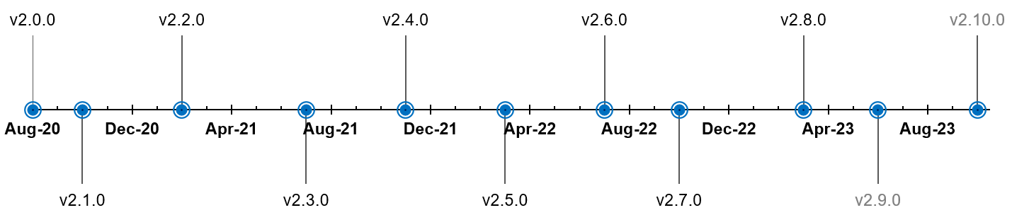
ESMValTool v2
Community diagnostic and performance metrics tool for evaluation and analysis of Earth system models
Open source community development on GitHub (> 200 developers, > 60 international institutes)
Used in several chapters of the Assessment Report 6 of the IPCC’s WG1
Release of v2.0.0 in August 2020, currently at v2.9.0
Scientific Documentation
Righi et al., GMD, 2020
Technical overview
Eyring et al., GMD, 2020
Large-scale diagnostics
Lauer et al., GMD, 2020
Diagnostics for emergent constraints and future projections
Weigel et al., GMD, 2021
Diagnostics for extreme events, regional and impact evaluation
Schlund et al., GMD, 2023
Evaluation of native ESM output
v2.9.0
Birgit Hassler, SPARC Training School, Kigali/Rwanda, 2023-10-29

Slide 11
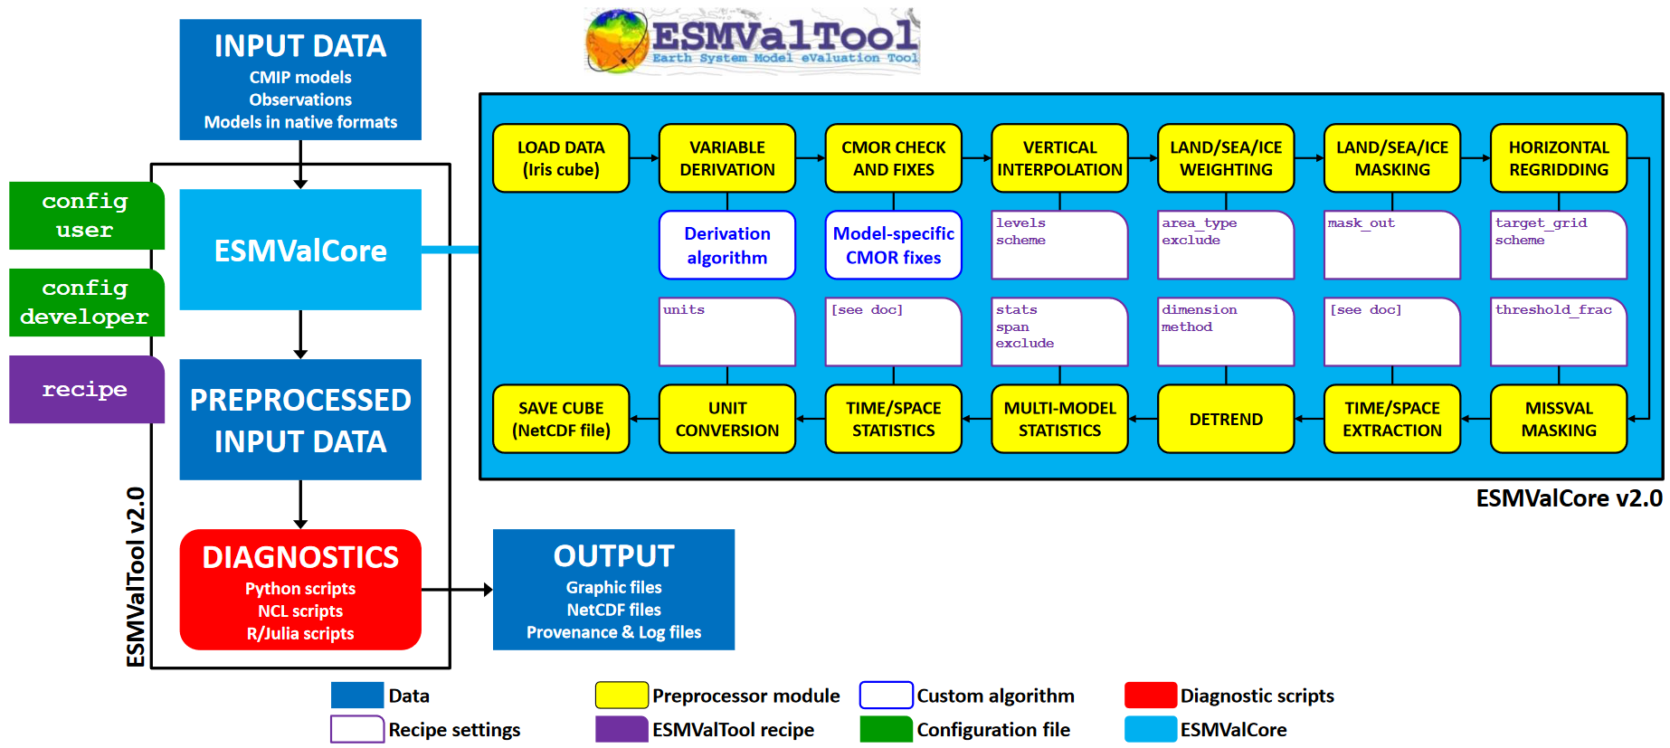
What is ESMValTool?
Righi et al., 2020.
Birgit Hassler, SPARC Training School, Kigali/Rwanda, 2023-10-29

Slide 12
Multi-model analyses
Birgit Hassler, SPARC Training School, Kigali/Rwanda, 2023-10-29

Slide 13
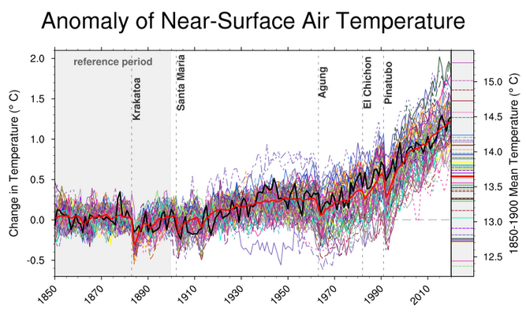

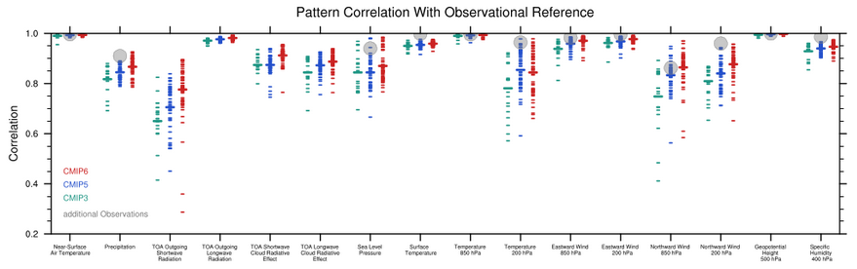
ESMValTool recipe examples, IPCC
IPCC AR6 WGI Chapter 3, 2021, Figure 3.4a.
IPCC AR6 WGI Chapter 3, 2021, Figure 3.43.
Birgit Hassler, SPARC Training School, Kigali/Rwanda, 2023-10-29

Slide 14
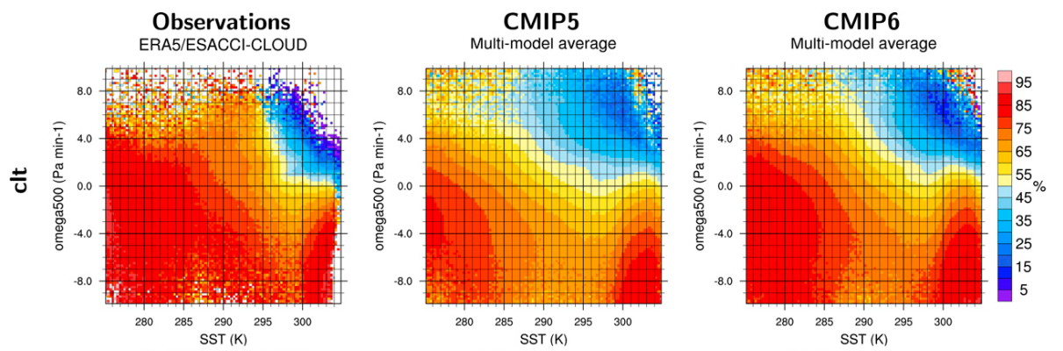
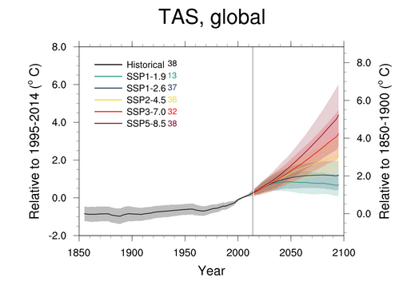
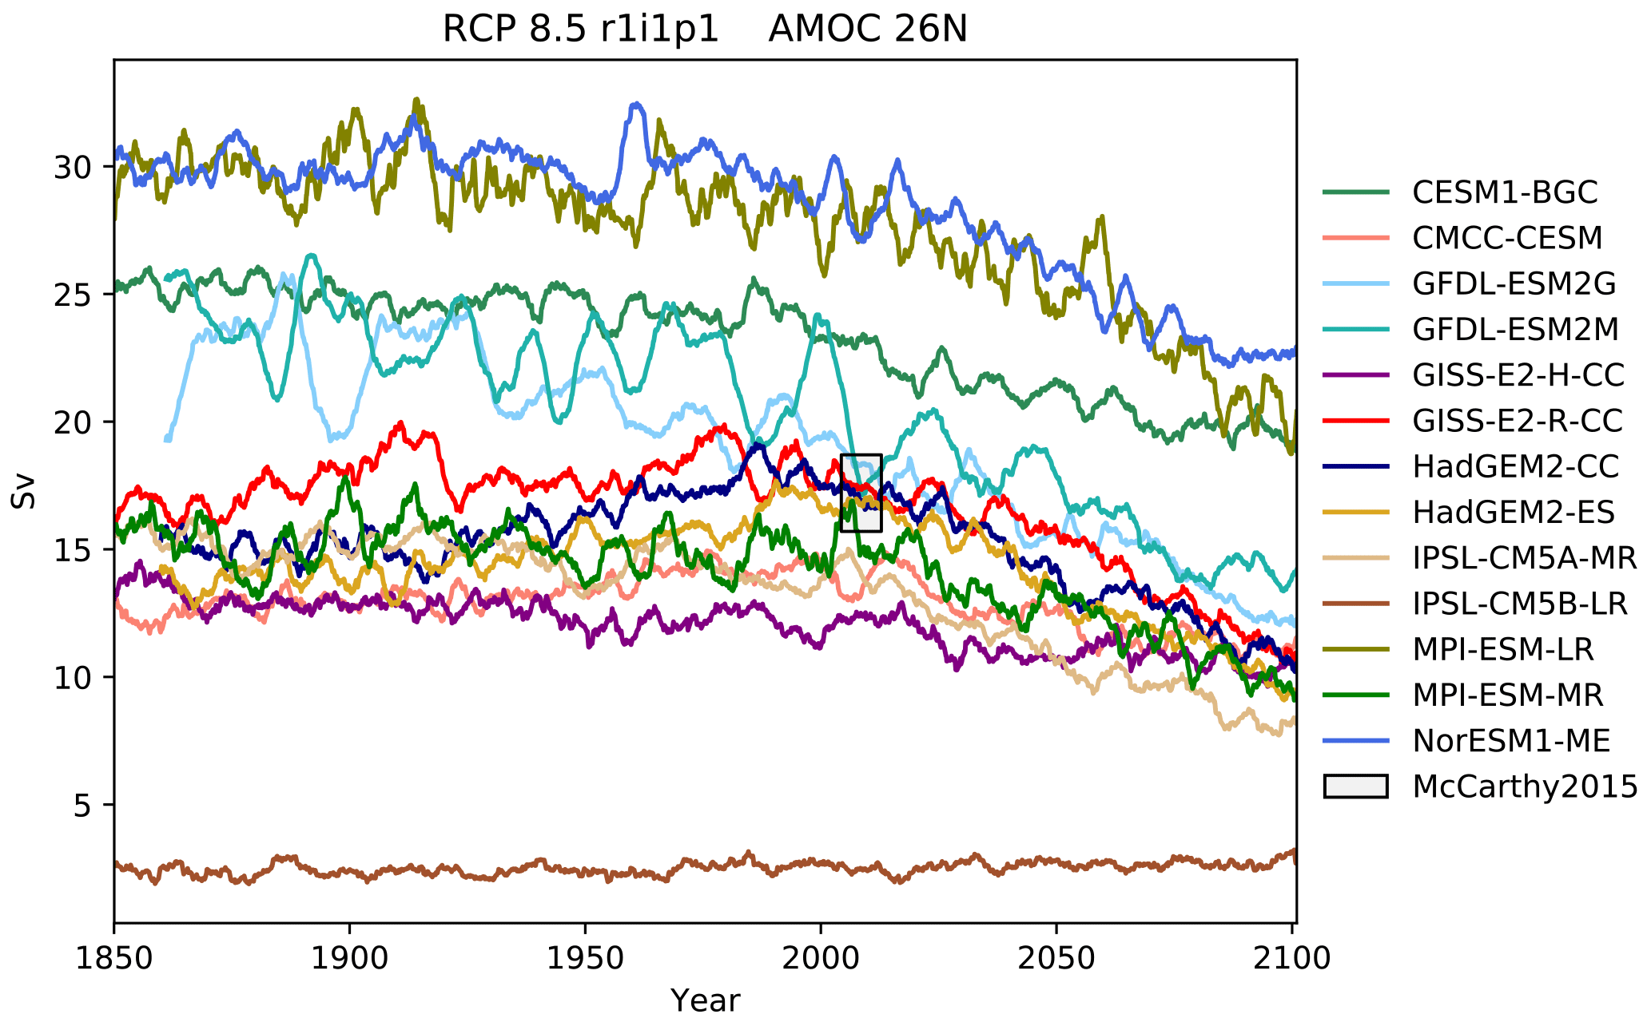

ESMValTool recipe examples, other
Lauer et al., 2023.
De Mora et al., 2018.
Tebaldi et al., 2021.
Birgit Hassler, SPARC Training School, Kigali/Rwanda, 2023-10-29

Slide 15

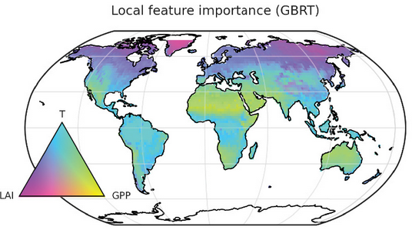
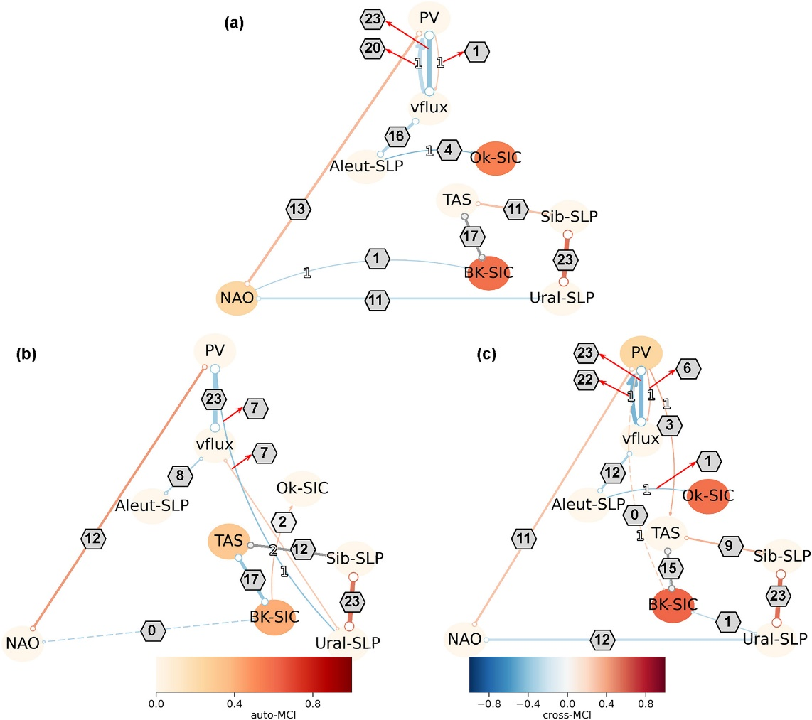

ESMValTool recipe examples, other
Galytska et al., 2023.
Schlund et al., 2020.
Birgit Hassler, SPARC Training School, Kigali/Rwanda, 2023-10-29

Slide 16
ESMValTool recent features
Automatic data downloader: wildcards are allowed in the recipe; direct connection to ESGF; flexible data discovery and usage
Observations and reanalyses: increasing number of observational and reanalysis datasets available; cmorization scripts available; common data pool on different HPC systems (e.g. DKRZ-Levante, CEDA-Jasmin…)
Preprocessor functions: increasing number of preprocessing functions available; increasing support of lazy data handling (so that very large datasets can be processed)
Birgit Hassler, SPARC Training School, Kigali/Rwanda, 2023-10-29

Slide 17
Analyses of observations/reanalyses
Birgit Hassler, SPARC Training School, Kigali/Rwanda, 2023-10-29

Slide 18
ESMValTool multi-dataset evaluation
Many different gridded satellite observations, hybrid datasets, and reanalysis are available to be used with ESMValTool – point source measurements (station data) is work in progress
Observations are not delivered with the source code of ESMValTool, rather scripts to download and format the obs so that they can be used alongside the model data
Data pool of formatted data is available on some HPC systems
New observations are constantly added, and there are guidelines available on how to add your own dataset
Birgit Hassler, SPARC Training School, Kigali/Rwanda, 2023-10-29

Slide 19
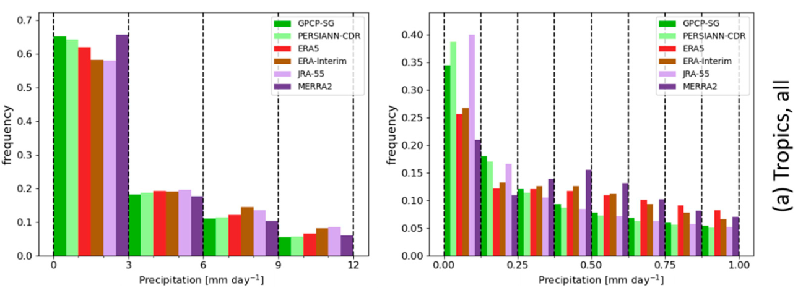
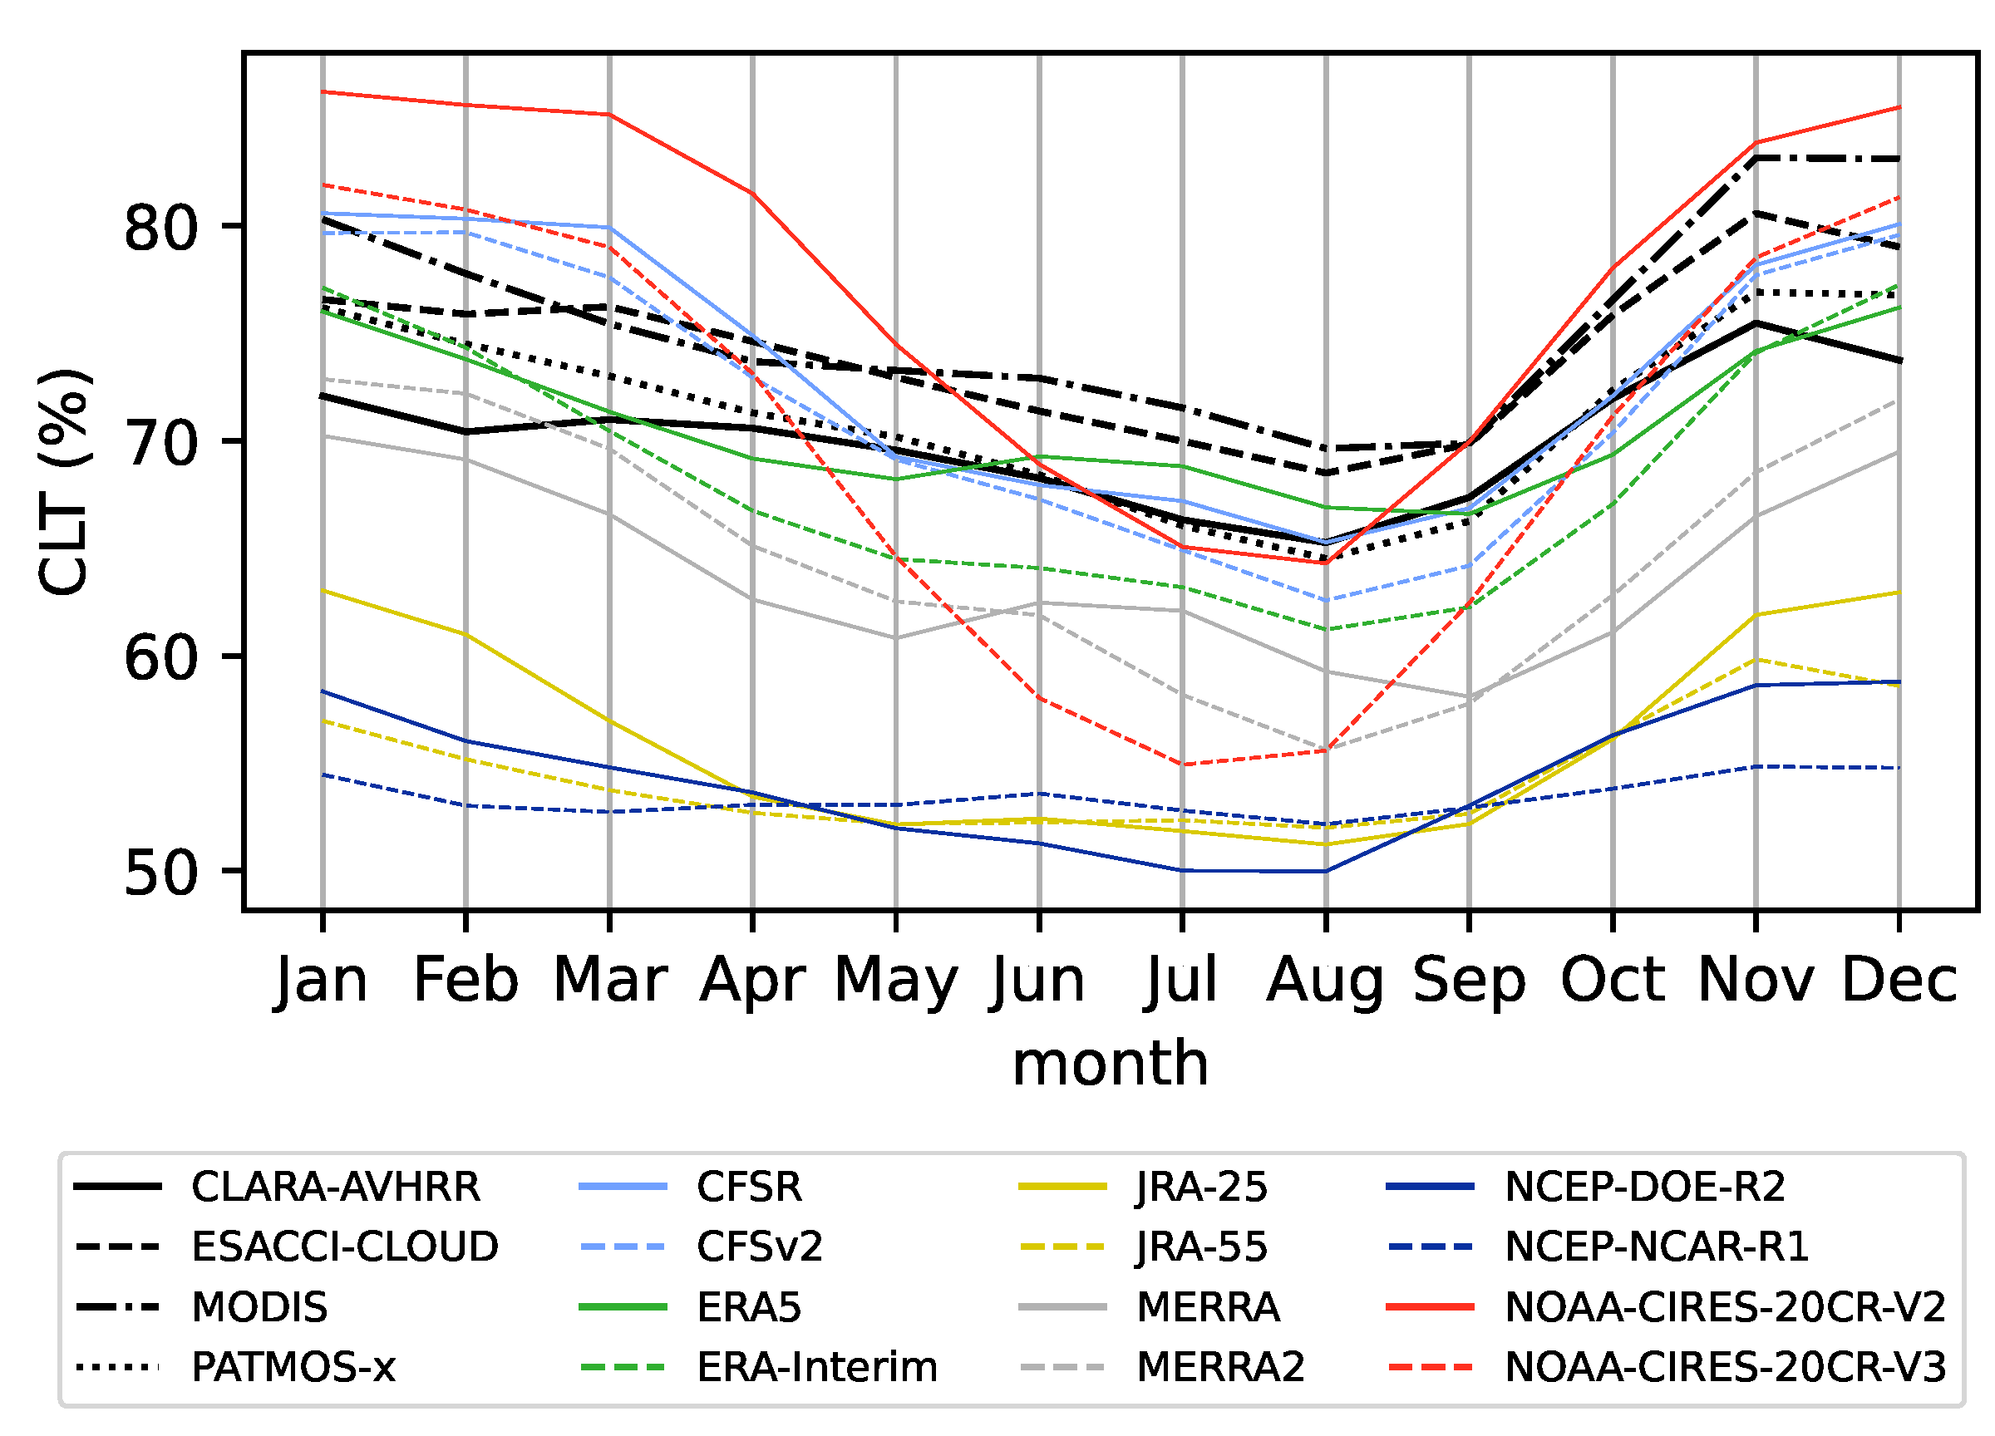
ESMValTool multi-dataset evaluation
Hassler & Lauer, 2021.
SPARC S-RIP phase 2.
NH storm track region
Birgit Hassler, SPARC Training School, Kigali/Rwanda, 2023-10-29

Slide 20
Analysis of native (model) data
Birgit Hassler, SPARC Training School, Kigali/Rwanda, 2023-10-29

Slide 21
Evaluation of Native Model Output
CMORized data
(netCDF from CMIP, …)
Find data
CMOR-like reformatting of native model output
Native model output
(netCDF, GRIB, …)
(1) Fixes for specific variables
(2) Fixes for all variables of MIP table
(3) Fixes for all variables
User input
(recipe, configuration files, …)
CMOR check
Further (customized) preprocessing
(regridding, extraction, masking, statistics, ...)
CMOR-compliant data
(netCDF)
ESMValCore
Preprocessed data
(netCDF)
Diagnostics
(Python scripts, Julia scripts, R scripts, NCL scripts)
Final output
(netCDF, graphics, …)
ESMValTool
Birgit Hassler, SPARC Training School, Kigali/Rwanda, 2023-10-29

Slide 22
Evaluation of Native Model Output
Native model output can be processed directly
No special user settings required
Rich collection of ESMValTool diagnostics is now fully available for analysis of native model output
CMORized data
(netCDF from CMIP, …)
Find data
CMOR-like reformatting of native model output
Native model output
(netCDF, GRIB, …)
(1) Fixes for specific variables
(2) Fixes for all variables of MIP table
(3) Fixes for all variables
User input
(recipe, configuration files, …)
CMOR check
Further (customized) preprocessing
(regridding, extraction, masking, statistics, ...)
CMOR-compliant data
(netCDF)
ESMValCore
Preprocessed data
(netCDF)
Diagnostics
(Python scripts, Julia scripts, R scripts, NCL scripts)
Final output
(netCDF, graphics, …)
ESMValTool
Birgit Hassler, SPARC Training School, Kigali/Rwanda, 2023-10-29

Slide 23
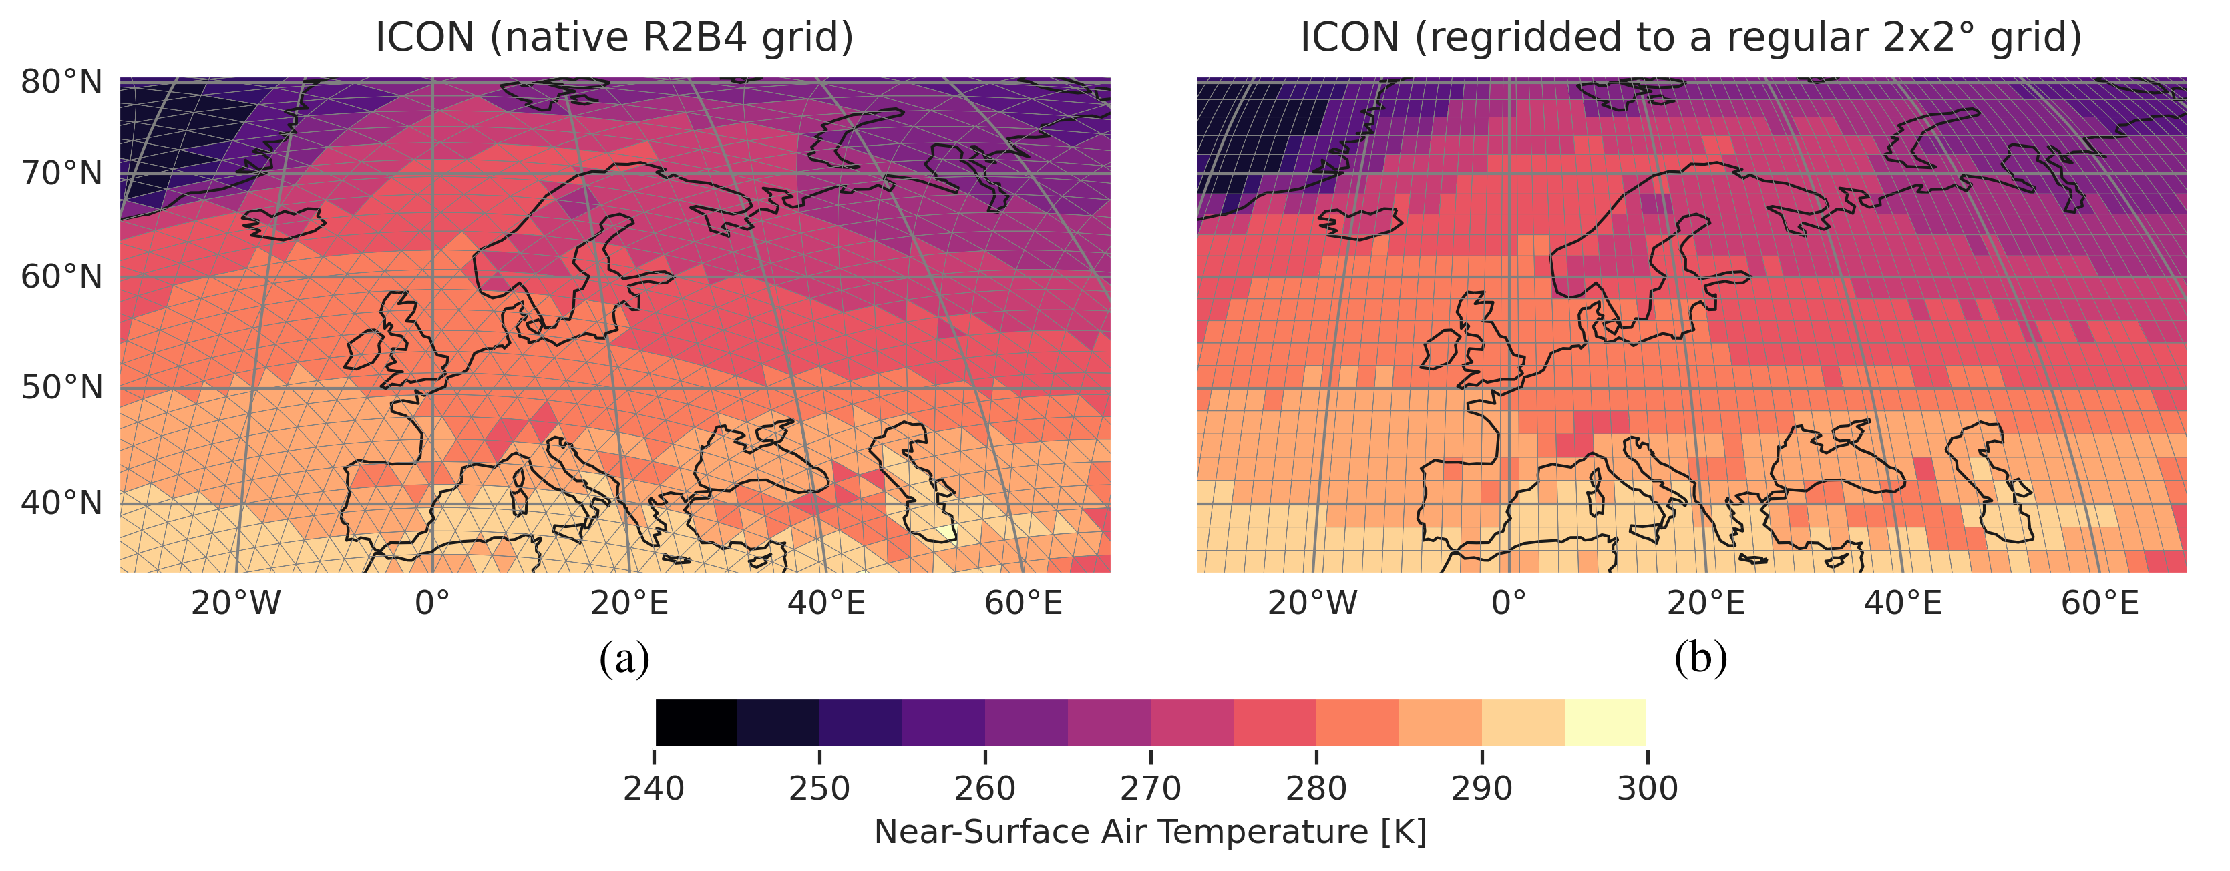
Enhanced Regridding of Unstructured Data (e.g., ICON)
Supported regridding algorithms for unstructured grids:
Nearest-neighbor
Bilinear
Area-weighted (first-order conservative)
Birgit Hassler, SPARC Training School, Kigali/Rwanda, 2023-10-29

Slide 24
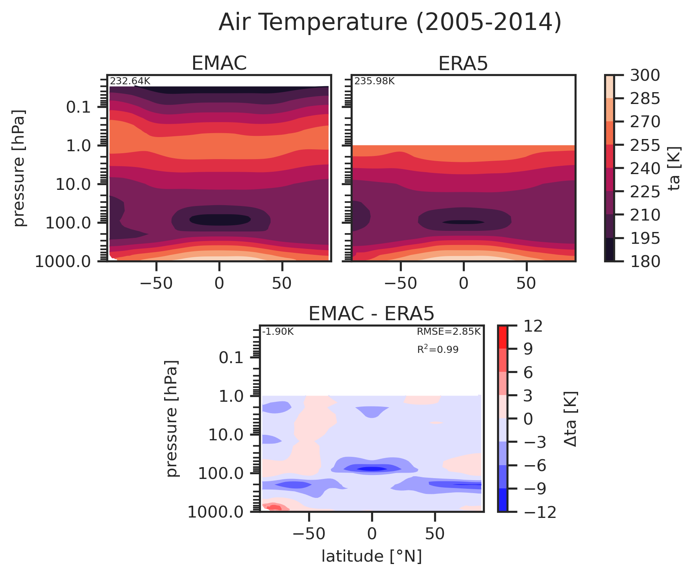
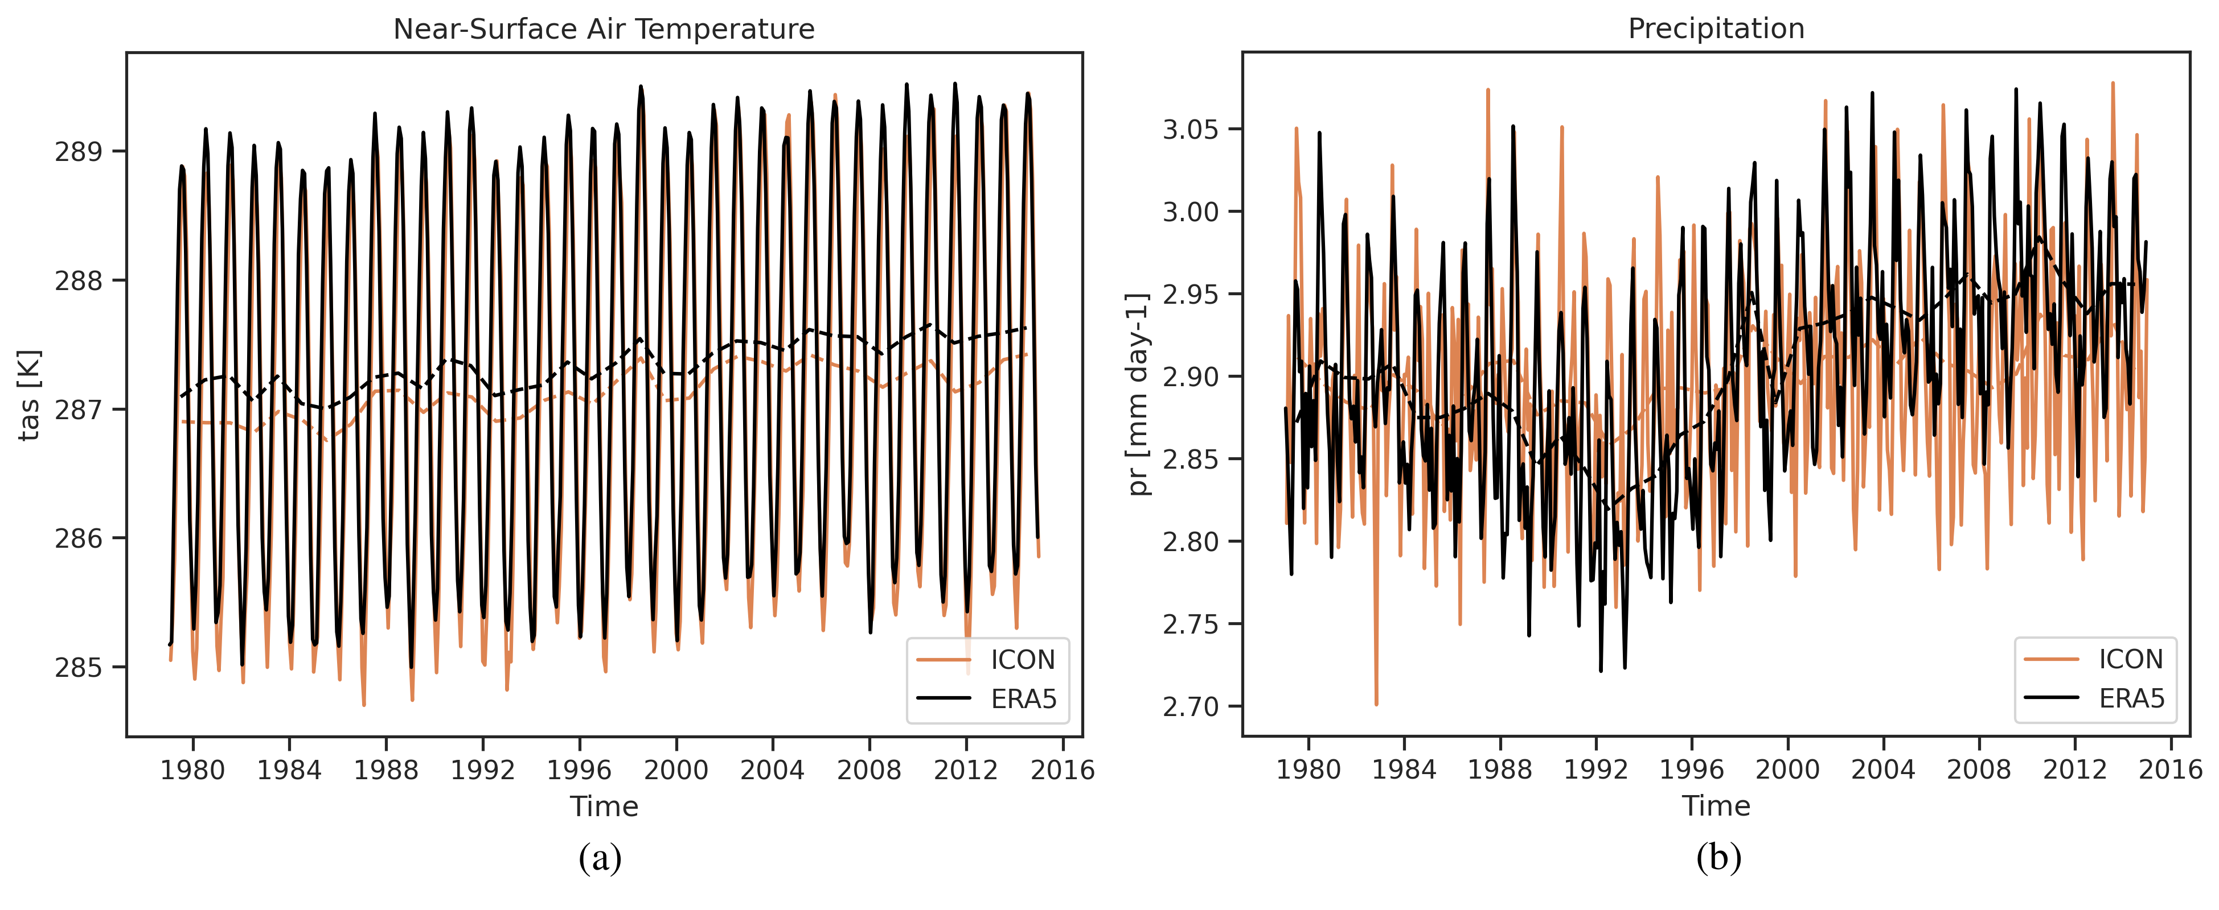
General-Purpose Diagnostics
New general-purpose diagnostics
Very easy to use
Highly customizable
Example use case: monitoring of running climate model simulations
Birgit Hassler, SPARC Training School, Kigali/Rwanda, 2023-10-29

Slide 25


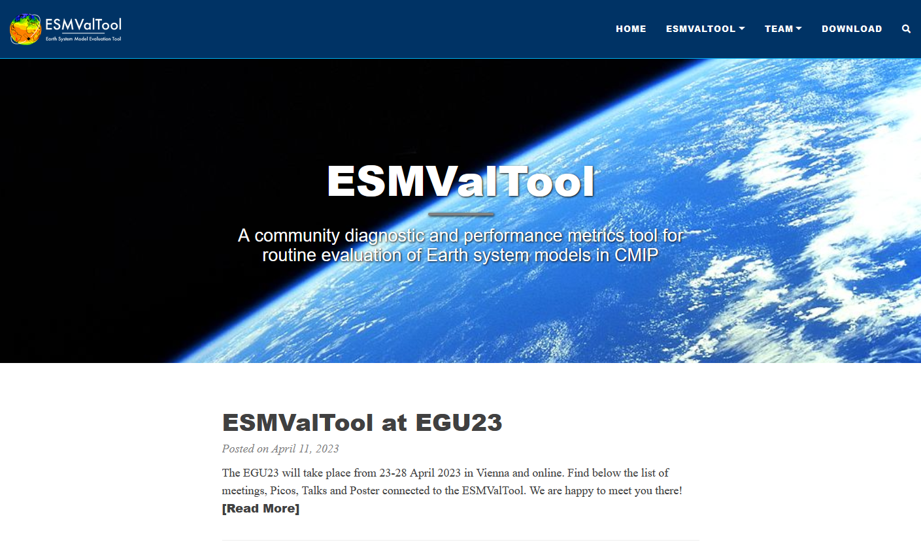

ESMValTool Information
1. GitHub repositories
https://github.com/ESMValGroup/ESMValTool
2. Documentation
https://docs.esmvaltool.org/
Decreasing complexity
3. Tutorial
https://esmvalgroup.github.io/ESMValTool_Tutorial/
4. Webpage
https://www.esmvaltool.org/
Follow us: @ESMValTool
Birgit Hassler, SPARC Training School, Kigali/Rwanda, 2023-10-29

Slide 26
Summary
Multi-model analyses
Extended functionalities for easier data access (CMIP and CORDEX simulations and observations)
Increasing number of simple and more complex diagnostics available for different realms (e.g. atmosphere, land, ocean, sea ice…)
Increasing number of preprocessor functions available for simplified data handling
Analyses of observations/reanalyses
Preprocessing and diagnostics can be applied to many different datasets, e.g. observations / reanalyses
Birgit Hassler, SPARC Training School, Kigali/Rwanda, 2023-10-29

Slide 27
Summary
Analysis of native (model) data
Cmorization on-the-fly available for several models (e.g. CESM2, EC-Earth3, EMAC, ICON, and IPSL-CM6) – could easily be expanded to more models
Example use case: simulation monitoring
Simple monitoring diagnostics available already and being expanded
Rich collection of more complex ESMValTool diagnostics fully available for analysis of native model output
Birgit Hassler, SPARC Training School, Kigali/Rwanda, 2023-10-29

Slide 28
Outlook
Things to come…
More updated preprocessor functions for memory efficient data handling and processing (e.g. important for high-resolution simulations)
Updating other I/O functions to improve memory efficient data handling
Adding more general purpose diagnostics (e.g. Hovmoeller plots) for simplified simulation monitoring and evaluation
Adding basic model evaluation recipes (general evaluation or focused on a specific topic like clouds or convection) for easier simulation evaluation
Plans to add chemical reanalysis data (e.g. CAMS) to facilitate new diagnostics focused on atmospheric chemistry
Add more tutorial episodes for advanced users
Birgit Hassler, SPARC Training School, Kigali/Rwanda, 2023-10-29

